Slide 1

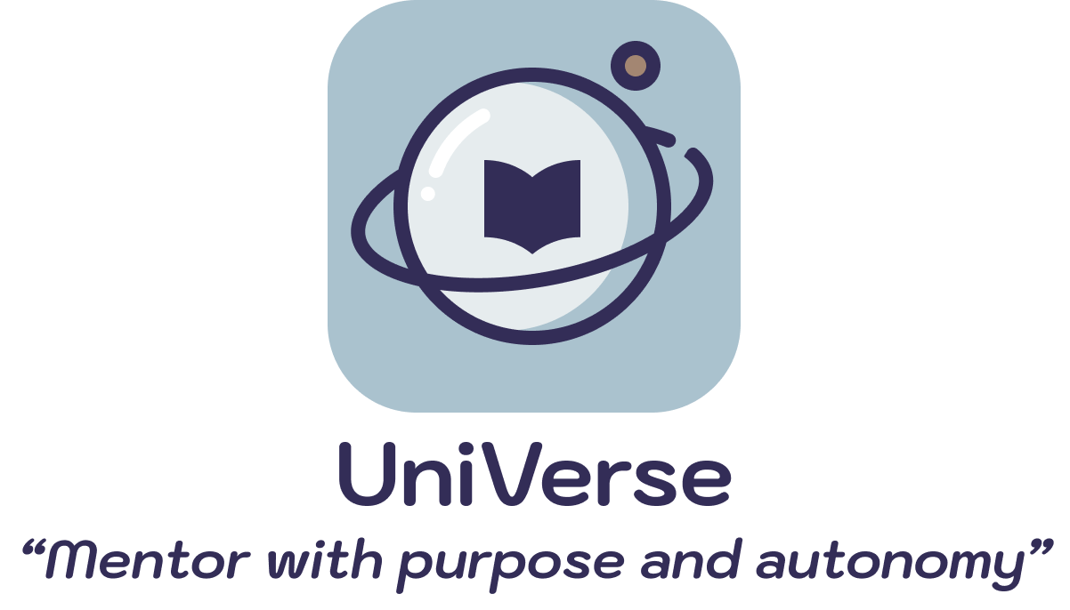


A4: Concept Video

Slide 2


WE WILL COVER...
01
05
Tasks
Project name & value proposition
02
06
Problem/solution overview
Storyboards
03
07
Market research
Video
04
08
Values in design
Appendix

Slide 3

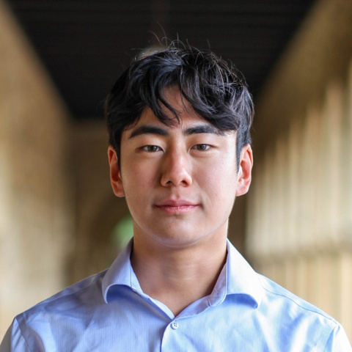
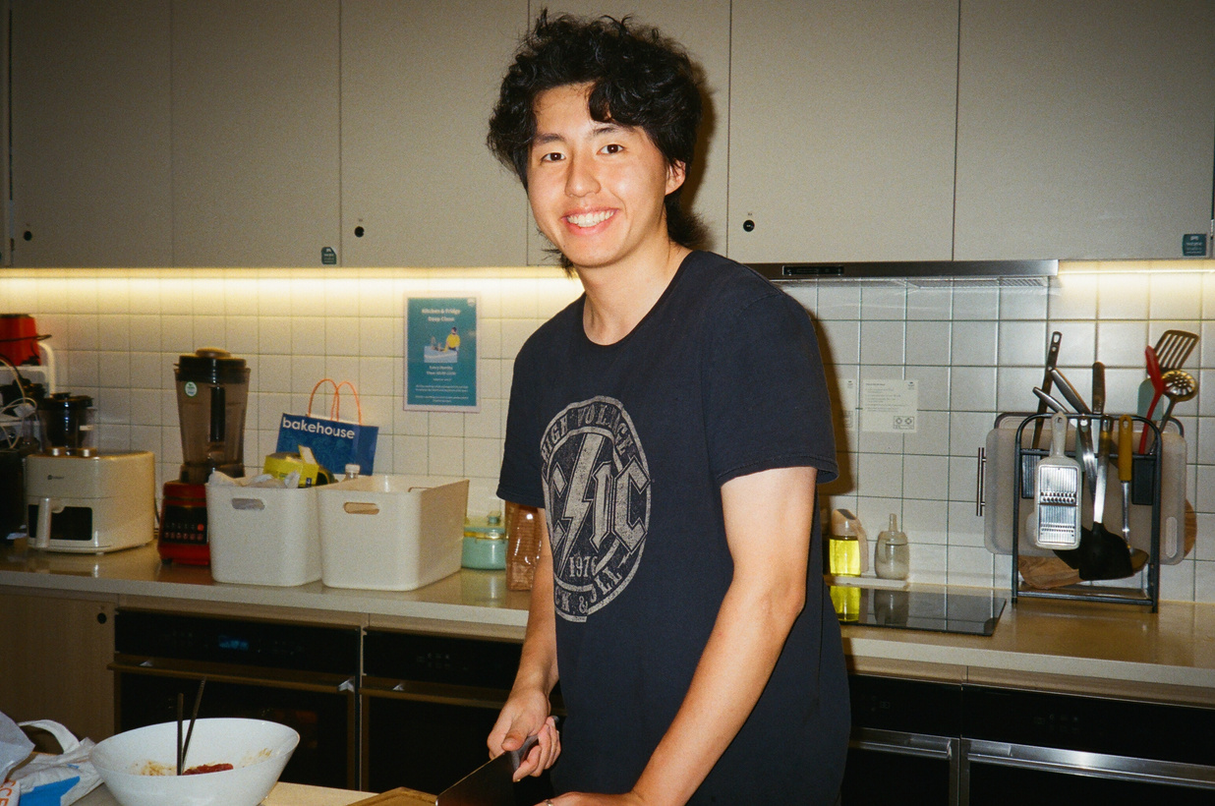
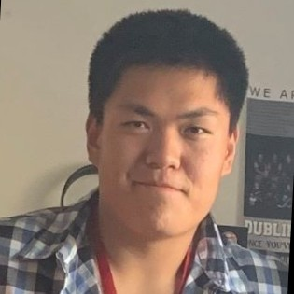
Meet the team!
Sally
Steve
ZIjian
ERIC
Economics ‘25
Hong Kong
CS ‘25
California
Symsys ‘26
Chengdu, China
CS ‘24
California

Slide 4


Project name and value proposition:
UniVerse
“Mentor with purpose and autonomy”
Value Proposition:
College mentorship reimagined with purpose and autonomy

Slide 5
Project name and value proposition:

Slide 6
Project name and value proposition:
UniVerse
Why we chose this name:
We wanted a name related to “universities” while capturing
the vast possibilities of niches and programs a prospective college applicant
might participate in.

Slide 7
Problem/solution overview
Problem you are tackling:
traditonal College Counselors are incentivized to only cater students advice for “top” universities not programs best for the student
Our Primary User:
College Counselors
Brief synopsis of your proposed solution:
An app to allow Counselors to choose to work with small groups of students with interests and backgrounds that cater to their own knowledge.

Slide 8
Market Research

Slide 9

What Cohort Does:
Cohort creates a specialized program for students in 9th, 10th, 11th, or 12th grade to get grade-specific college counseling information on a structured timeline.
Cohort
How UniVerse differs:
UniVerse’s primary user targets counselors.
UniVerse focuses on using specialized counselor knowledge to guide students, as opposed to pre-made curriculums/
Implication:
UniVerse creates a more focused consulting process that relies on working with counselors and utilizing their field-specific knowledge.

Slide 10

What Ivy Institute Does:
Ivy Institute offers college application advice specifically for the Ivy colleges. Many counselors have worked in Ivy League school admissions in the past.
How UniVerse differs:
UniVerse welcomes counselors from a range of backgrounds in order to mentor students with different interests.
Implication:
There lacks a space for counselors with a variety of backgrounds, passions, and interests in specific schools.
Ivy Institute

Slide 11
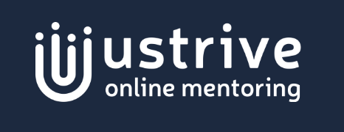
What UStrive Does:
UStrive is a web platform that connects students, especially from under-resourced areas, with college and career mentors.
Ustrive
How UniVerse differs:
We provide a platform that users of all backgrounds can use with helpful tools along the way, each tailored to their needs.
Implication:
The market lacks a platform that supports all types of students throughout the entire process.

Slide 12

What Crimson Does:
Counseling company that focuses on helping students get into competitive universities, mainly Ivy League schools, Oxford, and Cambridge.
Crimson Education
How UniVerse differs:
While Crimson uses AI as mostly a scheduling and logistical tool, UniVerse incorporate AI directly into assisting with application materials
UniVerse takes a personalized approach that aims to get students into schools that they would genuinely be happy with.
Implications
The college counslting industry is plagued by credentials-based advertising and a race to get the best “objective” rankings.

Slide 13
Values in Design:

Slide 14
Direct Stakeholders
Indirect Stakeholders
Parents
Peers of students
Traditional education consultant companies
Counselors
Students

Slide 15
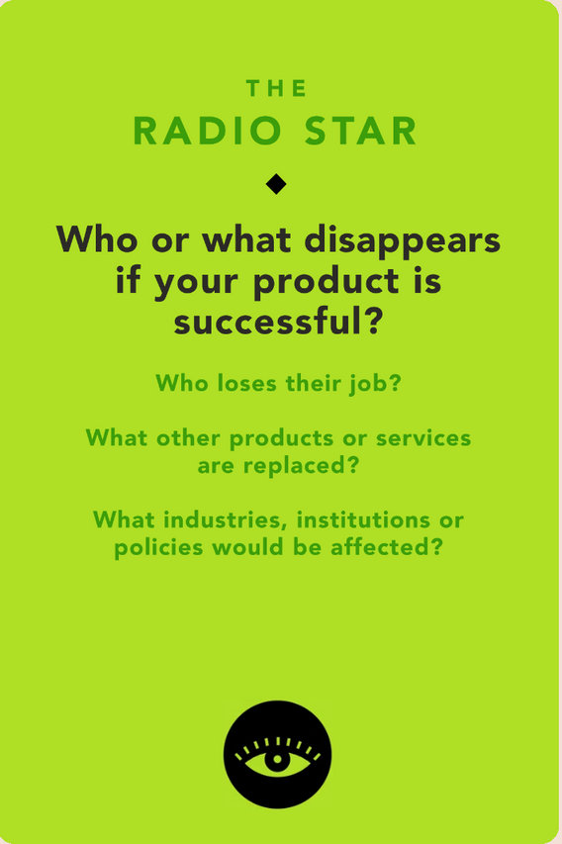
Ethical Implication 1:
“The Radio Star”
IMPLICATION:
Traditional counselors who work at bigger institutional agencies may be replaced.
REFLECTION:
To address this, we could introduce the app to those counselors, who may actually prefer to use our service. They would have greater autonomy in choosing their lessons and their students, but also receive greater compensation.

Slide 16
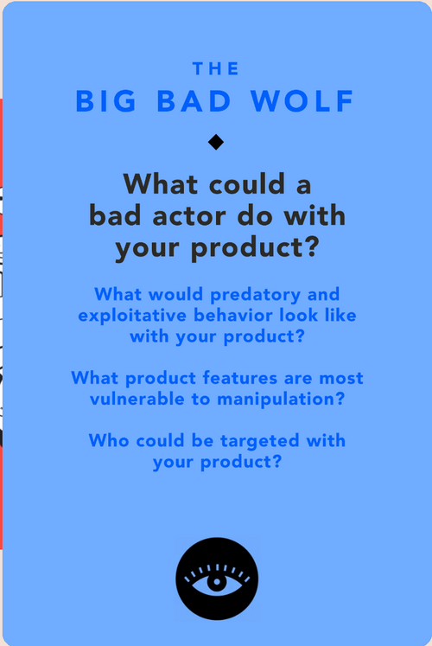
Ethical Implication 2:
“The BIG BAD WOLF”
IMPLICATION:
A bad actor could be a fraudulent counselor whose background is not vetted and gives poor advice on the platform, which may impact the performance of their students .
REFLECTION:
To address this, we could set up stringent background checks on the counselor candidates and make sure their experiences are vetted properly.

Slide 17
Tasks
 | Counselors (Primary User) | Students (Secondary User)
Simple | Counselors want students who they want to work with/with similar interests
Moderate | Counselors want to reach students without hassle | Students want to share information and help each other
Complex | Counselors want to stay organized and track their progress

Slide 18
TasK (Simple)
Counselors want to work with students with similar interests
Why this is simple:
This is the core of our product: every counselor will have autonomy in choosing students that best align with their own specialties.
Timestamp:
0:39-1:02

Slide 19
TasK (Moderate):
Counselors want to reach students without hassle
Why this is Moderate:
Once students and counselors are connected, they have autonomy to choose how their lessons are done, and many users will choose to stay on the app to use our AI-supported planning tools that are integrated with various stages of the application process.
Timestamp:
1:02-1:18

Slide 20
TasK (Moderate):
Students want to share information and help each other
Why this is Moderate:
Students are not forced to talk to or share any resources with other students, but having other students in the same class/counselor will increase collaboration.
Timestamp:
1:27-1:37

Slide 21
TasK (Complex):
Counselors want to stay organized and track their progress
Why this is Complex:
Typically, it is the responsibility of the counselor to stay organized and track their lessons. Adding capabilities will enhance their organizational skills and support users who choose to keep lessons on our platform and are looking for easy-to-use tools.
Timestamp:
1:18-1:26

Slide 22
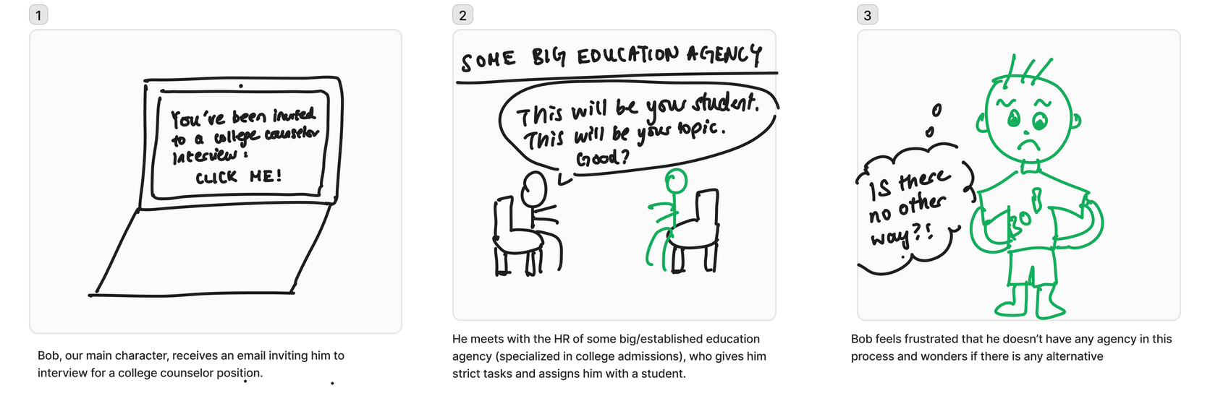
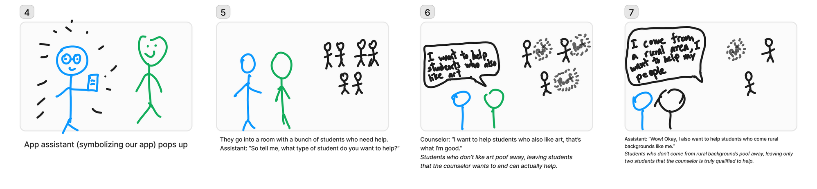
Our Story Board
Link to full: https://www.figma.com/board/ifDv1KSKAOpNIFJLu98SZv/CS147-video-demo?node-id=0-1&node-type=canvas&t=hwWFt7YA4GWPPcPb-0

Slide 23
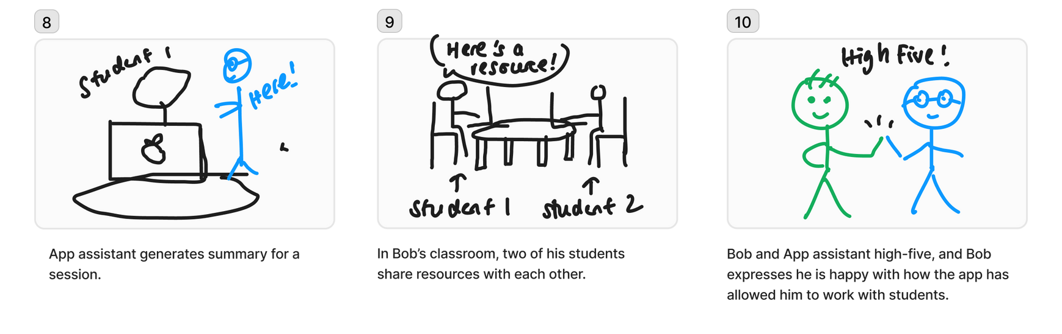
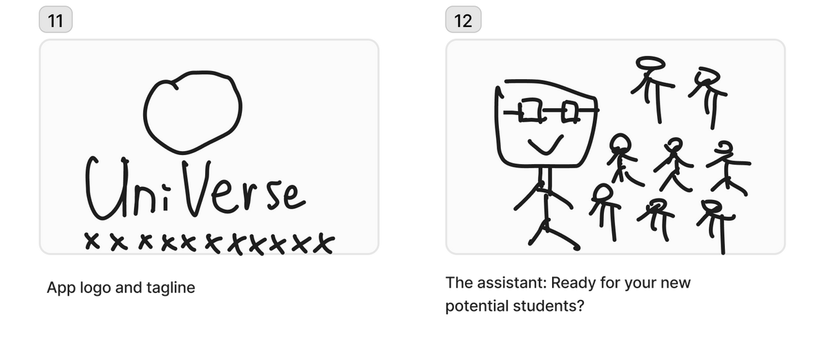
Our Story Board

Slide 24
OUR VIDEO!
[Universe concepT video]

